Slide 1
Puppet Basics

Slide 2
What is Puppet?
Puppet is a Free and Open Source software released under Apache License
Developed by Puppet Labs
Supported in Linux, Mac, BSD, Solaris and Windows based computer Systems
Written in ‘Ruby’ programming Language

Slide 3
Features of Puppet
Designed in such a way that it prevents duplication for everyone solving the same problem.
Mature Tool
Powerful Framework
Simplify System Administrator’s Technical Task.
System Administrator’s task is written in Puppet’s Native code and can be shared.
Makes it possible to make rapid and repeatable changes automatically.
Maintains System Consistency and Integrity.
Helpful in managing Physical and Virtual devices as well as cloud.

Slide 4
Current Users
  Google
  Stanford University
  Fedora
  Twitter
  SANS Institute
  Sun Oracle

Slide 5
Configuration
  Open TCP/UDP 8140 on server.
  Edit/create the necessary files:
    /etc/puppet/puppet.conf
      Main Puppet daemon(s), both client and server, configuration file.
    /etc/puppet/manifests/site.pp
      Central manifest capable of configuring an entire site.
    /etc/puppet/manifests/nodes.pp
      Contains node definitions.
    /etc/puppet/manifests/templates.pp (optional)
      Contains template class definitions.
  Start the central daemon (Puppet Master):
    /etc/init.d/puppetmaster start

Slide 6
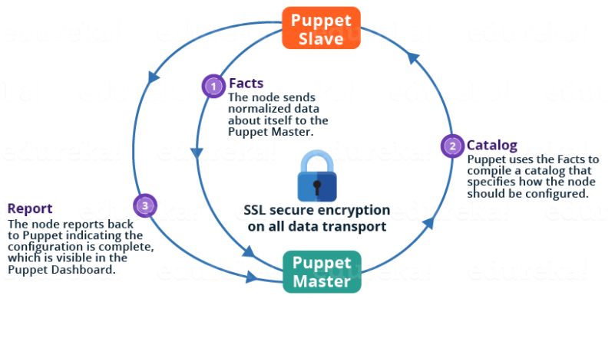
Architecture
Notes:
The Puppet Agent sends the Facts to the Puppet Master. Facts are basically key/value data pair that represents some aspect of Slave state, such as its IP address, up-time, operating system, or whether it’s a virtual machine. I will explain Facts in detail later in the blog.
Puppet Master uses the facts to compile a Catalog that defines how the Slave should be configured. Catalog is a document that describes the desired state for each resource that Puppet Master manages on a Slave. Puppet Slave reports back to Master indicating that Configuration is complete, which is visible in the Puppet dashboard.

Slide 7
Puppet master-slave communication
Puppet Slave asks for Puppet Master certificate.
After receiving Puppet Master certificate, Master requests for Slave certificate.
Once Master has signed the Slave certificate, Slave requests for configuration/data.
Finally, Puppet Master will send the configuration to Puppet Slave.

Slide 8
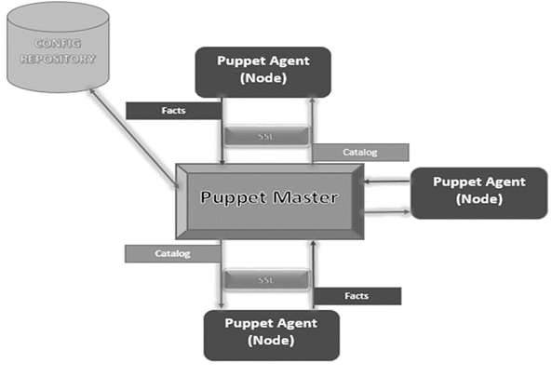

Slide 9
Components of Puppet
Manifests: Every Slave has got its configuration details in Puppet Master, written in the native Puppet language. These details are written in the language which Puppet can understand and are termed as Manifests. They are composed of Puppet code and their filenames use the .pp extension. These are basically Puppet programs.
Module: A Puppet Module is a collection of Manifests and data (such as facts, files, and templates), and they have a specific directory structure. Modules are useful for organizing your Puppet code, because they allow you to split your code into multiple Manifests. Modules are self-contained bundles of code and data.
Resource: Resources are the fundamental unit for modeling system configurations. Each Resource describes some aspect of a system, like a specific service or package.
Facter: Facter gathers basic information (facts) about Puppet Slave such as hardware details, network settings, OS type and version, IP addresses, MAC addresses, SSH keys, and more. These facts are then made available in Puppet Master’s Manifests as variables.

Slide 10
Mcollective: It is a framework that allows several jobs to be executed in parallel on multiple Slaves. It performs various functions like:
Interact with clusters of Slaves, whether in small groups or very large deployments.
Use a broadcast paradigm to distribute requests. All Slaves receive all requests at the same time, requests have filters attached, and only Slaves matching the filter will act on requests.
Use simple command-line tools to call remote Slaves.
Write custom reports about your infrastructure.
Catalogs: A Catalog describes the desired state of each managed resource on a Slave. It is a compilation of all the resources that the Puppet Master applies to a given Slave, as well as the relationships between those resources. Catalogs are compiled by a Puppet Master from Manifests and Slave-provided data (such as facts, certificates, and an environment if one is provided), as well as an optional external data (such as data from an external Slave classifier, exported resources, and functions). The Master then serves the compiled Catalog to the Slave when requested.

